Slide 1

Slide 1
Terry Stops
Rebecca Mih
5/2020

Slide 2



Slide 2
TERRY STOPS – WHAT ARE THEY ?
Terry Stop
Terry Patdown
Arrest
Terry stops are allowed since 1968 ruling Terry v. Ohio
Based on “Articulable Reasonable Suspicion” (ARS) of potential past, present or future criminal conduct
Includes discussion and “minimally intrusive seizure”
Seizure under State
And Federal Law
Reasonable belief of a concealed weapon
Applies to people &
Vehicles
Subject is not free to leave
2
Notes:
Need to locate reference

Slide 3

Business Objective: Improving Effectiveness of Terry Stops
Since 2015, Seattle has been collecting Terry Stop Data, and since 2017 provided the data and dashboard online for public data analysis
Roughly 41,000 Terry Stops were performed in this time period, 25% of which resulted in arrests or forward for prosecution
Purpose of this report is to identify specific attributes that lead to more or fewer arrests
2015
Seattle PD starts
Open platform
2018
Seattle PD Creates Open Data platform for all to use
Publishes 2015-2017 report
2019
Seattle PD publishes
2018 report, announces online platform availability
2020
The data used today was
Downloaded April 15, 2020
2017
2016
Seattle starts Terry
Data collection 6/2016
Dataset: https://www.kaggle.com/city-of-seattle/seattle-terry-stop
2
Notes:
Reports: Seattle Police Department https://assets.documentcloud.org/documents/6136893/SPDs-2019-Annual-Report-on-Stops-and-Detentions.pdf

Slide 4
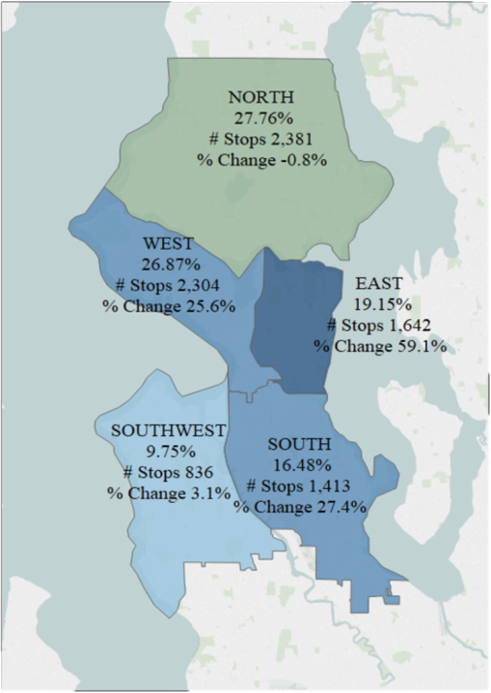
Overview of the Seattle Dataset: 7/2015 – 4/2020
~41,000 unique terry stops (rows), with 25% resulting in arrest
or forwarded for further prosecution
Data Features:
* Terry Stop ID
* GO /SC ID
* Officer ID
* Subject ID
* Report Date
* Report time
* Initial Call Type
* Final Call Type
* Call Type
* Stop Resolution
* Weapon type
* Officer Squad
* Officer Year of Birth
* Perceived Age of subject
* Race of officer
* Perceived Race of subject
* Gender of officer
* Perceived Gender of subject
2017-2018 data
Highlighted Features are those used in analysis
Engineered Features
* Day of the week
* Monthly cadence
* Precinct
* Watch
* Officer Age
2

Slide 5
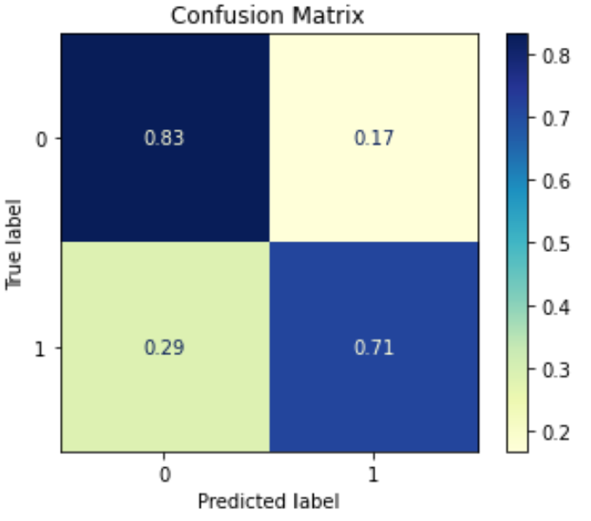
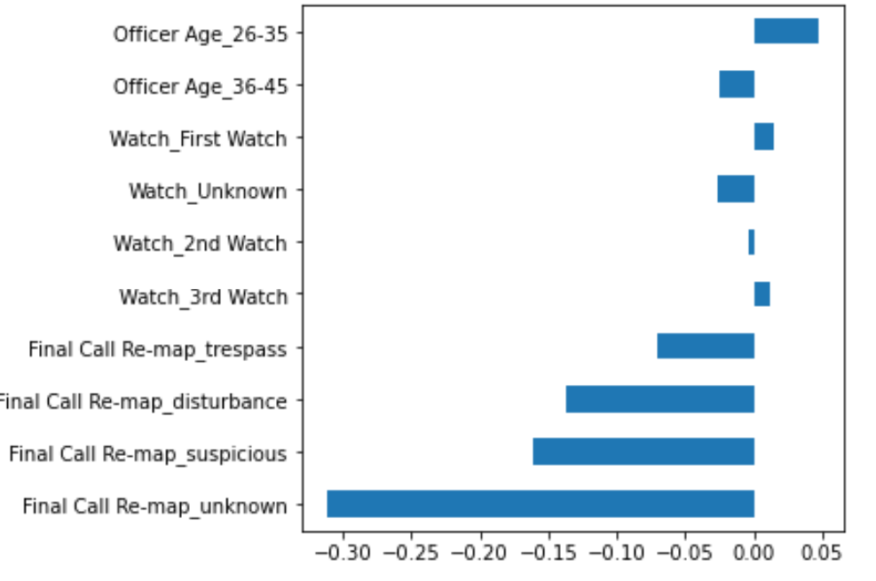
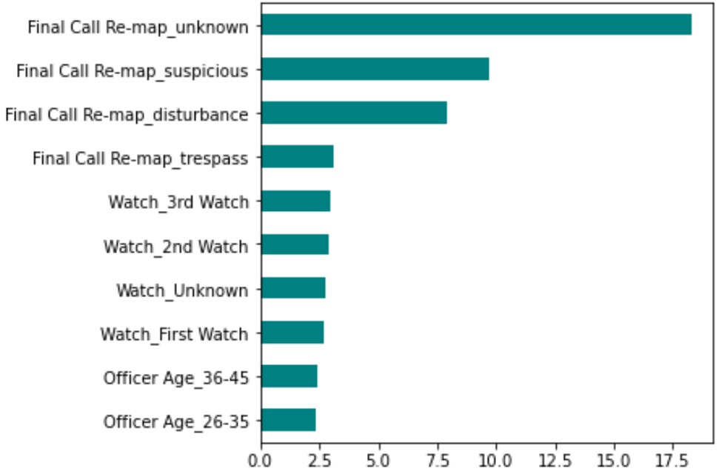
Slide 4
Key Model Findings
Arrest
Prediction
Accuracy
Final Call Type
Is critical for
Predicting Arrests
40%
Nuisance calls do not lead to arrests
70%
80%
80% Accuracy
71% Arrest Prediction
83% Non-Arrest Prediction
The watch impact on arrests is 10%
Officers Age also plays a role
1st Watch (3am-11am, and 3rd Watch (7 pm – 3am) are where most Arrests are made
Younger officers more likely to pull Watch 3.
4

Slide 6

Slide 10
Summary
A classification model was constructed with 80% arrest accuracy
The most important features which predict Terry Stop arrests are the Final Call Type
Gender and race do not appear to contribute significantly to the prediction
Your logo
10

Slide 7
Slide 10
Next Steps
Given most Terry Stops do not result in arrest, realize that at least 70% of the disturbance calls likely result in no arrest
However, since 50% of Terry stops are due to 911 calls, ignoring community calls (911) is not a good idea.
Considering adding more workforce on 1st and 3rd shift to maximize arrest rates
Your logo
10

Slide 8
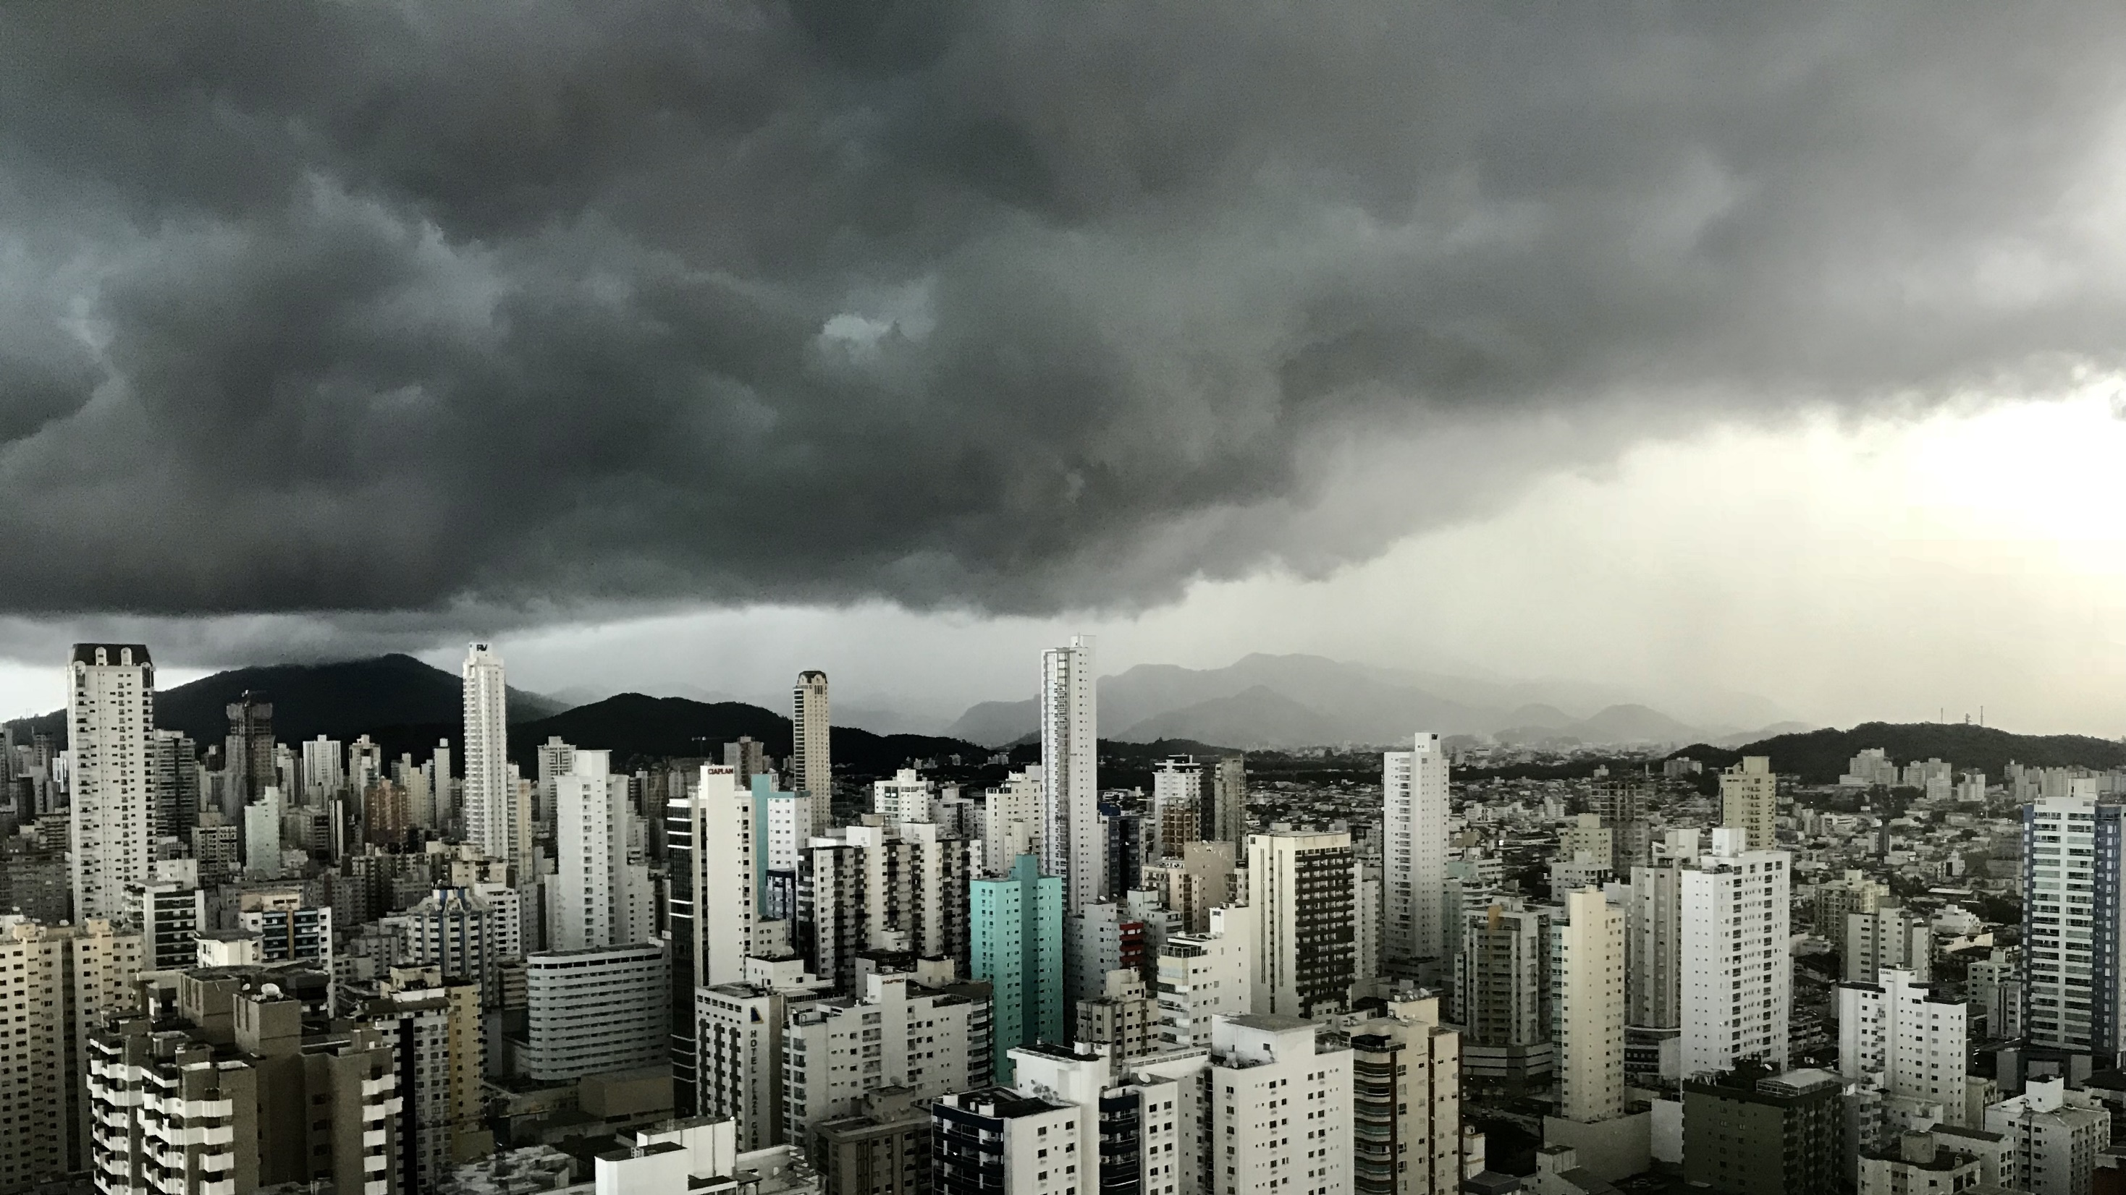
Slide 11
THANK YOU

